Slide 1
Traffic Trekker

Slide 2

Introduction
We are trying to create a network packet analyzer. It allows you to capture and analyze network packets in real-time, making it a valuable tool for network monitoring and debugging.
It's particularly useful for diagnosing network issues, monitoring traffic, and gaining a deeper understanding of network behavior.

Slide 3
Table of contents
01
02
03
04
05
06
Algorithm
Pseudo Code
Flow Chart
Modern Tool Usage
& Application of engineering principles
Code & Output
Social Relevance & consideration during the development of project

Slide 4
Algorithm used for the Project
Import the PyShark Library:
- The code will begin by importing the `PyShark` library. This library is used for capturing and analyzing network packets.
2. Define the `analyze_packet` Function:
- The `analyze_packet` function is defined to process and analyze each captured packet.
It takes one argument, `packet`, which represents a captured network packet.
It will simply print the source and destination IP addresses of each packet.
3. The Main() Function:
The `main` function is the entry point of the script.
Set the ‘interface’ variable to the name of the network interface you want to capture packets from (‘WI-FI’).
Set the ‘capture_filter’ variable to a capture filter to specify which packets to capture. {‘tcp’ for TCP packets}
Set the ‘time_limit’ variable to a maximum duration(in seconds) for capturing packets.

Slide 5
4. Creating a Live packet capture object:
Create a ‘pyshark.LiveCapture’ object named ‘capture’ with the specified ‘interface’, ‘display_filter’, and ‘timeout’ settings.
The ‘timeout’ settings will ensure that the packet capture will stop after specified duration (‘time_limit’).
5. Start capturing packets in a loop:
Use a ‘try’ block a capture packets continuously in a loop using ‘capture.sniff_continuously()’.
For each packet captured, call the ‘analyze_packet(packet)’ function to perform analysis on the packet.
If a ‘keyboard Interrupt’ (CTRL+C) is detected, print “Exiting…….” and exit the loop.
6. Execute the ‘main()’ function:
The ‘if__name__==__main__”:’ block ensures that the ‘main()’ function is executed when the script runs the main program.

Slide 6
Pseudo Code
Define a function analyze_packet(packet):
Print "Source IP: packet.ip.src, Destination IP: packet.ip.dst"
Define a function main():
Set interface to "Wi-Fi"
Set capture_filter to "tcp"
Set time_limit to 10
Create a capture object using pyshark.LiveCapture with the specified interface, capture_filter, and timeout settings
Try:
Start an infinite loop to continuously capture packets:
For each packet captured:
Call analyze_packet(packet) to analyze and print source and destination IP addresses
Except when a KeyboardInterrupt is raised:
Print "Exiting..."
If this script is executed as the main program, call main().

Slide 7
Flow Chart
START
Initialize the Wi-Fi Interface
Initialize TCP
(Capture_filter)
Initialize
Time_limit = 10

Slide 8
Using PyShark
Create Live Capture
Define the interface i.e. add a function for interface
Capture Network Packets
Call the Function of Analyze Packet
If the keyboard Interrupts
Else
Print “Exiting”
Stop

Slide 9
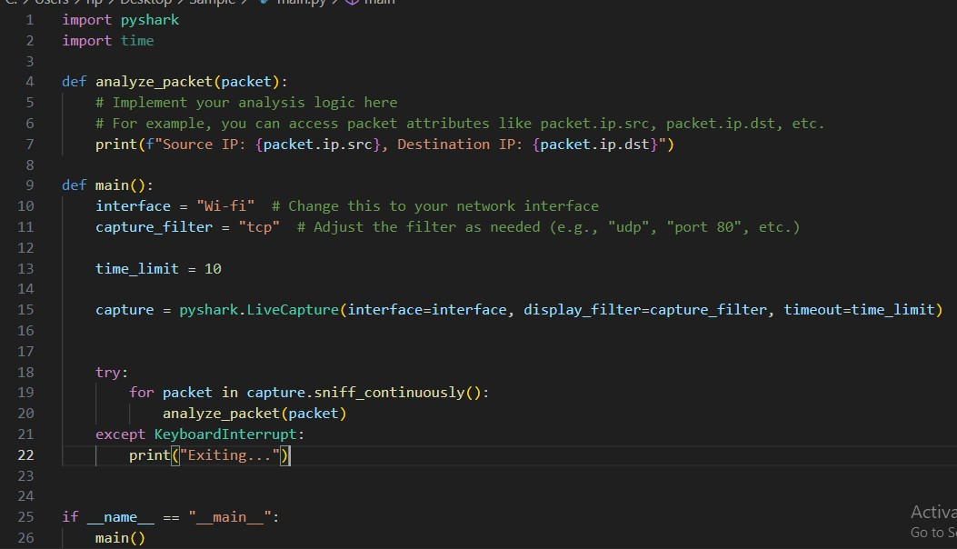

Slide 10
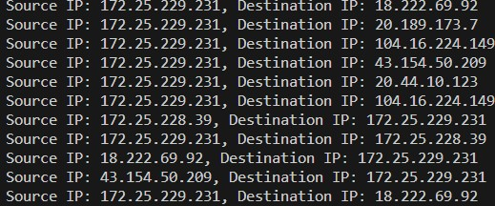
OUTPUT
The output of the provided code will display the source and destination IP addresses of network packets that match the specified capture filter (in this case, TCP packets).
In this output:
- "Source IP" corresponds to the source IP address of a captured packet.
- "Destination IP" corresponds to the destination IP address of the same packet.
Each line of output represents the analysis result for a single captured packet. The code continuously captures packets and prints their source and destination IP addresses as long as it is running.
The actual IP addresses displayed in the output will vary depending on the network traffic on your specified network interface and the capture filter you set. If you have a variety of network traffic, you will see different IP addresses for different packets.

Slide 11
How it is different from Wireshark
Traffic Trekker and Wireshark serve similar purposes is that they both capture and analyze network packets. However, there are significant differences between the two:
1. Automation and Customization:
- The code uses the PyShark library to capture and analyze network packets programmatically. It allows you to automate packet capture and analysis according to your specific requirements.
- Wireshark is a graphical user interface (GUI) tool that provides a more interactive and user-friendly way to capture and analyze packets. While it offers extensive features, it may not be as easily customizable or automated as a custom Python script.
2. Programmatic Control:
- The code allows you to have programmatic control over packet capture and analysis. You can define your analysis logic, filter packets based on specific criteria, and integrate packet capture into a larger application or system.
- Wireshark is primarily designed for manual inspection and analysis by human users. It does not offer the same level of programmatic control and automation as a custom script.

Slide 12
3. Flexibility:
- The Python script can be customized to capture and analyze packets in ways that are not easily achievable with Wireshark alone. We can implement complex analysis, integrate with other tools and libraries, and automate tasks such as logging or alerting based on specific network conditions.
- Wireshark is more focused on providing a comprehensive GUI for packet inspection and analysis, and while it does have some scripting capabilities, they are not as flexible as a full-fledged programming language like Python.
4. Integration:
- The Python script can be integrated into larger systems or used as part of a network monitoring or security solution. It allows you to build custom applications that incorporate packet capture and analysis.
- Wireshark, being a standalone tool, is typically used by network administrators, security analysts, and other professionals for manual troubleshooting and analysis tasks.

Slide 13
Applications
1. Networking Fundamentals: The code assumes a basic understanding of networking principles, including concepts like IP addresses, TCP/IP protocols, and network interfaces.
2. Software Engineering: This code follows software engineering best practices by defining functions (`analyze_packet` and `main`) for modularity, readability, and maintainability.
3. Network Capture: The `pyshark.LiveCapture` class from the PyShark library is used to capture network packets from a specified network interface. Engineering principles related to data capture and real-time monitoring of network traffic are applied here.
4. Packet Analysis: The `analyze_packet` function performs analysis on each captured packet. Engineers would typically apply various analysis techniques, such as protocol decoding, payload inspection, and anomaly detection, depending on the specific use case.
:

Slide 14
5. Error Handling: The code includes error handling using a try-except block to catch the `KeyboardInterrupt` exception (typically triggered by pressing Ctrl+C) to ensure a graceful exit. This demonstrates engineering principles related to robustness and reliability.
6. Configuration Management: Configuration parameters like the network interface (`interface`), capture filter (`capture_filter`), and time limit (`time_limit`) are defined as variables at the beginning of the script, making it easy to modify these parameters without changing the core logic of the code. This adheres to principles of configuration management and flexibility.
7. Security Considerations: When working with network traffic analysis, security principles and best practices are crucial. Engineers should ensure that the code and network monitoring activities are compliant with security policies and regulations.

Slide 15
Social Relevance & consideration during the development of project
Network Security and Privacy: It can be used for legitimate purposes such as network security monitoring, where organizations monitor their networks for security threats and anomalies.
Cybersecurity: In the context of cybersecurity, it can be used to detect and mitigate cyberattacks, helping organizations defend against threats like malware, ransomware, and unauthorized access. It contributes to the overall security of digital infrastructure, which is vital in today's interconnected world.
Network Performance Optimization: Network traffic analysis is essential for optimizing network performance. By identifying inefficient network traffic patterns, it can help organizations improve the speed and reliability of their networks.
Compliance and Regulation: Organizations in various industries are subject to data protection and privacy regulations (e.g., GDPR, HIPAA). Network traffic analysis tools can help ensure compliance by monitoring data flows and identifying potential violations.

Slide 16
Incident Response: In the event of a network breach or incident, this code can be a valuable tool for incident responders to quickly analyze network traffic and identify the scope and impact of the incident. It aids in the rapid mitigation of threats.
Network Infrastructure Monitoring: Beyond security, network traffic analysis is used to monitor the health and performance of critical infrastructure, such as telecommunications networks and data centers. It ensures the reliability of essential services.
Open Source and Community Contribution: The code's use of PyShark, an open-source library, demonstrates the importance of open-source tools in the field of network analysis. It encourages community collaboration and knowledge sharing.
It's essential to emphasize responsible and ethical use of network traffic analysis tools like the one demonstrated in the code. Social considerations, legal compliance, and respect for privacy should always be at the forefront when deploying such tools in any context

Slide 17
Modern Tool Usage
Here's how the code leverages modern tools and libraries:
1. PyShark Library: PyShark is a modern and user-friendly Python library for interacting with packet capture files and live network traffic. It provides a Python interface to the popular Wireshark tool, making it easier for developers to work with network packets programmatically.
2. Live Packet Capture: The code uses PyShark's `Live Capture` class to perform live packet capture from a specified network interface. This is a modern approach to real-time network monitoring and analysis, allowing you to capture packets as they traverse the network.
3. Display Filter: PyShark allows you to set display filters (specified as `capture_filter`) to capture only the packets of interest. This modern feature helps narrow down the focus of your analysis to specific types of packets or protocols.
4. Packet Analysis: PyShark simplifies the process of packet analysis by providing a high-level API to access packet attributes. This makes it easier to extract information from packets, such as source and destination IP addresses, as demonstrated in the `analyze_packet` function.
5. Integration: Modern tools like PyShark can be integrated with other Python libraries and frameworks, enabling you to build comprehensive network monitoring and analysis solutions. This integration capability is crucial in modern network management scenarios.

Slide 18
Members:
Kshitij Parag Ukey (22BCY10139)
Ansh Garg (22BCY10178)
Khushi Kumari (22BCY10275)
Kashinath R. (22BCY10094)
Nupur Shivani (22BCY10066)

Slide 19
Thanks

Slide 22
Contents of this template

